Slide 1
AngularJS
Controller, Scope and Modules
Lecture 3
By James(Jin) Wang
08/01/2019

Slide 2
Outline
AngularJS Architecture Patterns
The Role of Controllers
The ng-controller Directive
The Role of Modules
Adding a Controller to a Module

Slide 3
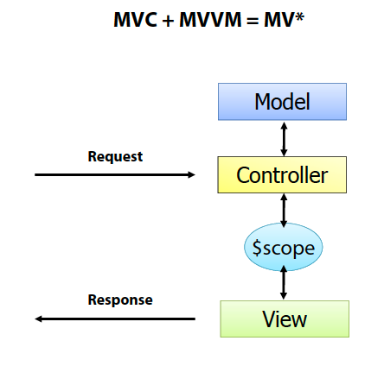
Controller, Scope and Modules
  AngularJS Architecture Patterns:
  AngularJS relies on two key architecture patterns:
  (1) Model-View-Controller (MVC)
  (2) Model-View-ViewModel (MVVM)
  Patterns provide prescriptive guidance that can be used to build applications

Slide 4
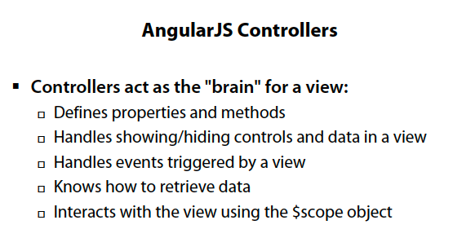
Controller, Scope and Modules
  The Role of Controllers:

Slide 5
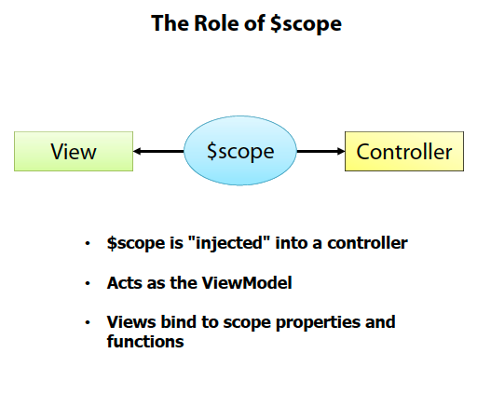
Controller, Scope and Modules

Slide 6
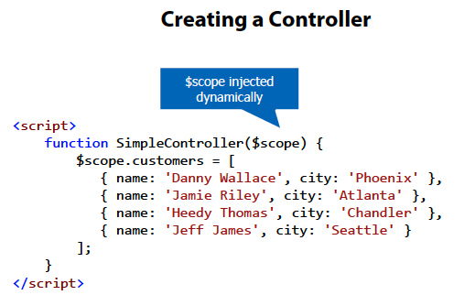
Controller, Scope and Modules

Slide 7
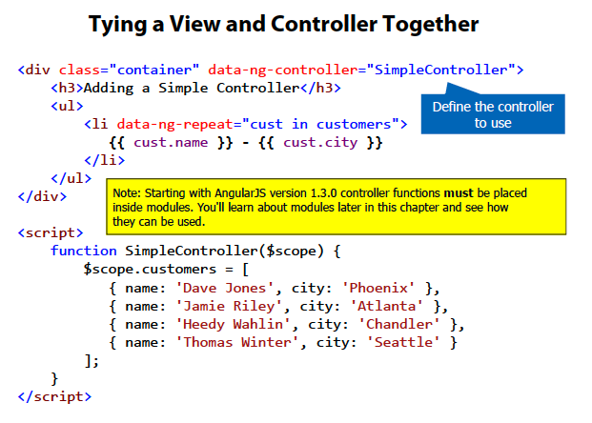
Controller, Scope and Modules
  The ng-controller Directive:

Slide 8
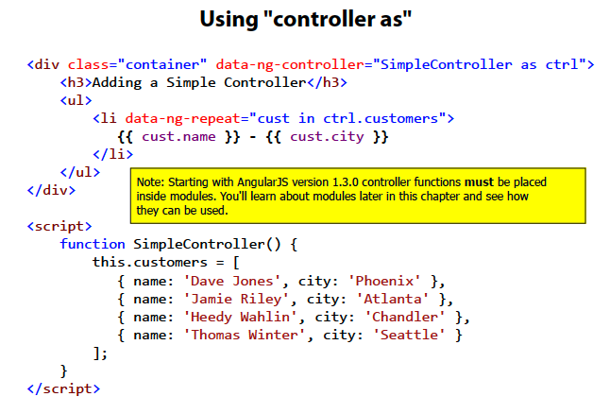
Controller, Scope and Modules

Slide 9
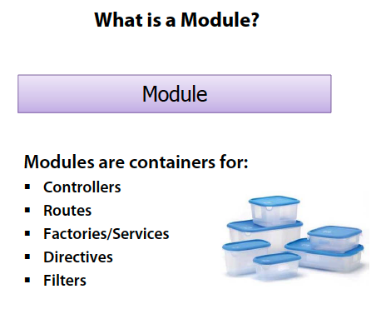
Controller, Scope and Modules
  The Role of Modules:

Slide 10
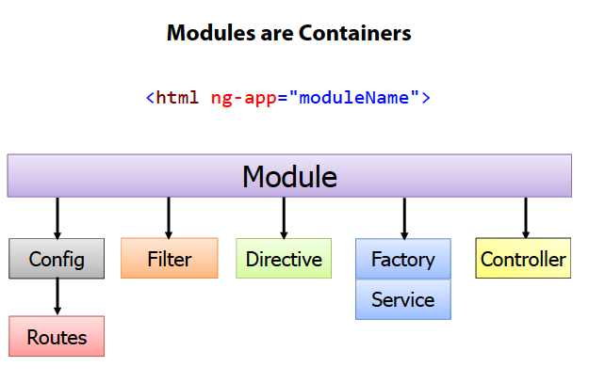
Controller, Scope and Modules

Slide 11
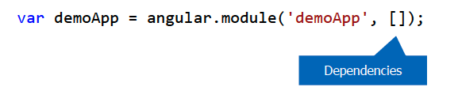
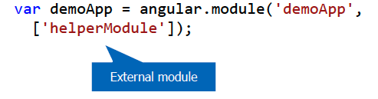
Controller, Scope and Modules
  Defining a Module:
  Create a module using angular.module():
  Injecting Dependencies into a Module:
  Modules may rely on functionality from other modules
  Helper modules can be “injected” into a module:

Slide 12
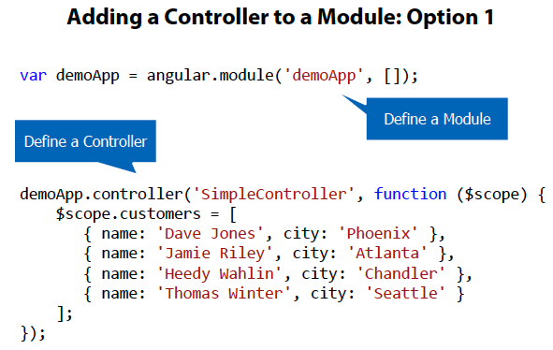
Controller, Scope and Modules
  Adding a Controller to a Module:

Slide 13
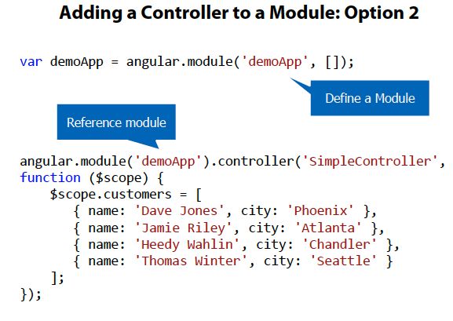
Controller, Scope and Modules

Slide 14
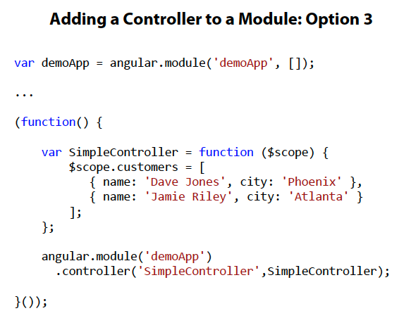
Controller, Scope and Modules

Slide 15
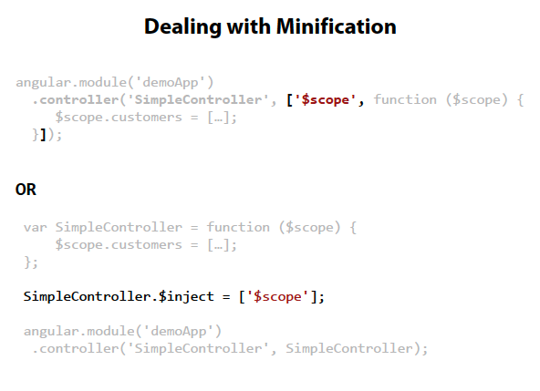
Controller, Scope and Modules

Slide 16
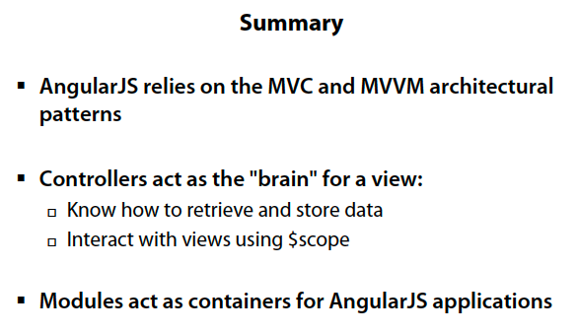
Controller, Scope and Modules

